Slide 1
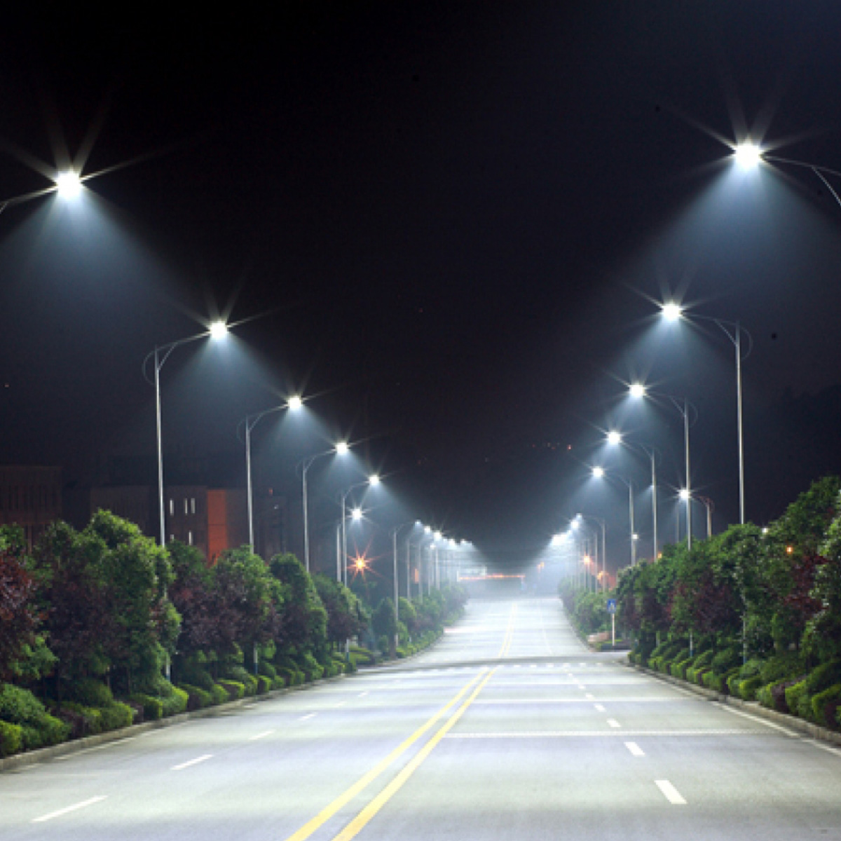
Street Light Automation

Slide 2
Materials used
Arduino uno R3
Light diode resistance(LDR)
Light emitting diode(LED)
Infrared sensor
Jumper wire
Interfacing board
4.7kΩ resistor

Slide 3
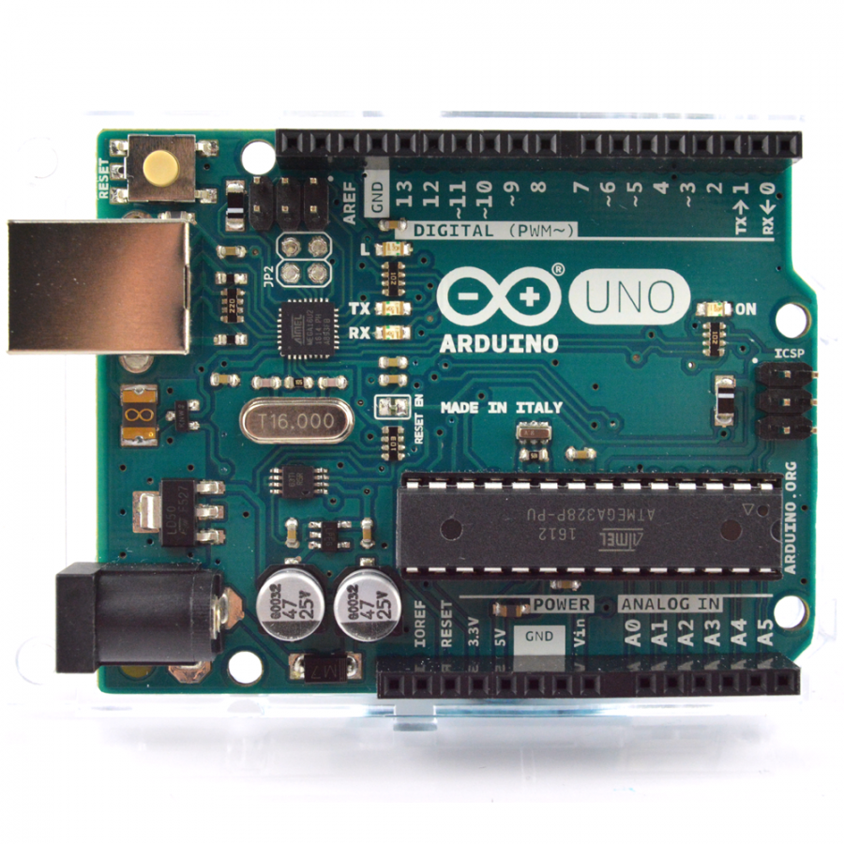
Arduino UNO R3
Specification
Board Name | Arduino Uno R3
0perating Volt | 5V
Clock Speed | 16MHz
Digital i/o | 14
Analog Inputs | 6
Pulse width modulation(PWM) | 6
Universal asynchronous receiver-transmitter (UART) | 1
Programming Interface | USB via ATMega16U2

Slide 4
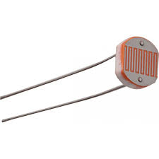
Light dependant resistor
An LDR is a component that has a (variable) resistance that changes with the light intensity that falls upon it. This allows them to be used in light sensing circuits.

Slide 5
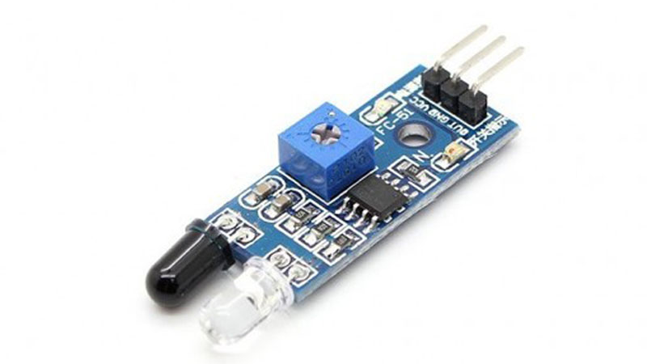
Infrared sensor
An infrared sensor is an electronic instrument which is used to sense certain characteristics of its surroundings by either emitting and/or detecting infrared radiation.
Infrared sensors are also capable of measuring the heat being emitted by an object and detecting motion

Slide 6
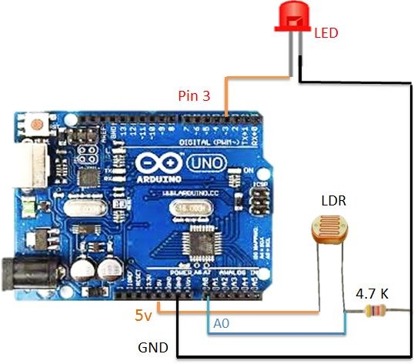
Concept of Led and LDR Interfacing
Hardware Connections.-
Arduino 3rd pin connected to LED +ve
Arduino GND connected to LED -ve through 4.7k
Arduino +5v is connected to LDR One End
Arduino A0 pin is connected to LDR other end
Arduino GND is connected to LDR other end with 4.7k

Slide 7
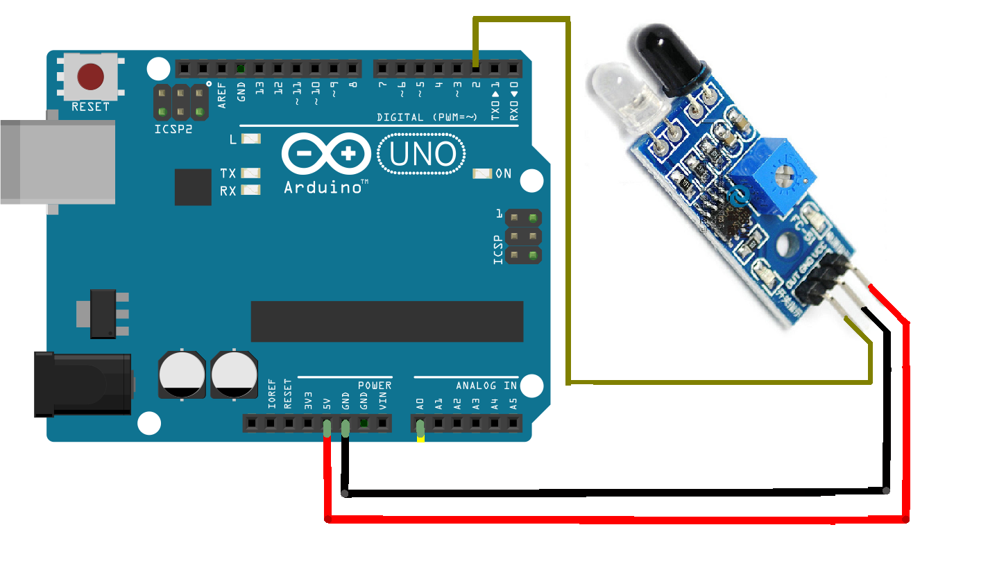
Concept of IR Sensor interfacing
IR sensor has three pins GND, Vcc, out.
GND pin is connected gnd slot of Arduino for grounding.
Vcc is connected to 5v pinof arduino.
Out pin is connected to one of the input slot of Arduino to read sensed data.

Slide 8
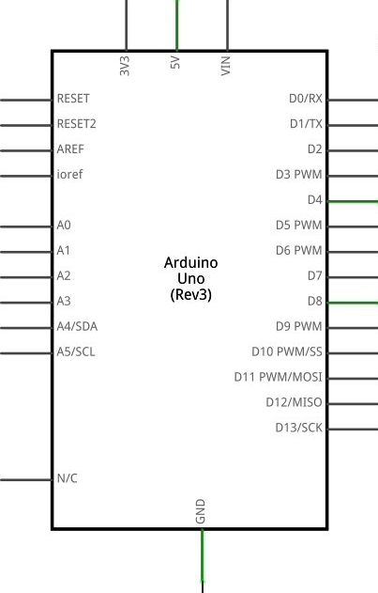

Circuit designing
LDR
LED
IR sensor
Resistor(4.7Ω)

Slide 9
#include <SoftwareSerial.h>
int sensorPin = A0; // select the input pin for the LDR
int sensorValue = 0; // variable to store the value coming from the sensor
int led = 3;
void setup() {
// declare the ledPin as an OUTPUT:
pinMode(led, OUTPUT);
pinMode(5,OUTPUT);
Serial.begin(9600);
pinMode(A1,INPUT);
pinMode(A2,OUTPUT);
pinMode(A3,OUTPUT);
digitalWrite(A2,HIGH);
digitalWrite(A2,LOW);
}
void loop()
{
Serial.println("Darkness");
sensorValue = analogRead(sensorPin);
Serial.println(sensorValue);
/*if (sensorValue < 100)
{
Serial.println("LED Dim");
analogWrite(led,5);
//delay(10000);
}*/
if(sensorValue<100 && analogRead(A1)<500)
{
Serial.println("LED bright");
for(int i=0;i<255;i++){
analogWrite(led,i);
analogWrite(5,i);
}
delay(10000);
}
else if(sensorValue < 100)
{
Serial.println("LED Dim");
analogWrite(led,5);
analogWrite(5,5);
//delay(10000);
}
else
{
digitalWrite(led,LOW);
digitalWrite(5,LOW);
//delay(sensorValue);
}
}

Slide 10
THANK YOU

